Slide 1
Recursion

Slide 2
Recursion!
When a method calls itself to solve some problem.
MUST HAVE AN EXIT CONDITION!
Failure to do so will result in a stack overflow exception.

Slide 3
Philosophy
If the given instance of the problem is small or simple
Just solve it
Otherwise, reduce the problem to one or more simpler instances of the same problem.

Slide 4
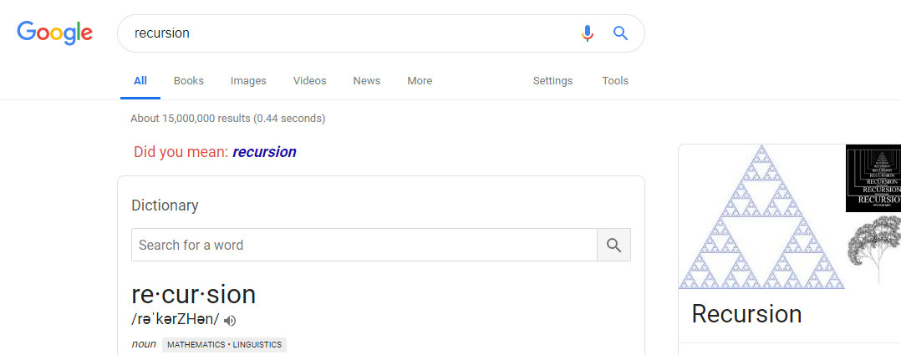
Google memes

Slide 5
Example
Client hires boss to create application that does X, Y, and Z.
Boss tells leaders A, B, and C to do X, Y, and Z respectively.
Leaders A tells code monkeys to do X₁, X₂, and X₃
Leaders B tells code monkeys to do Y₁, Y₂, and Y₃
Leaders C tells code monkeys to do Z₁, Z₂, and Z₃
Code monkeys calculate and return results to leaders
Leaders return results to boss
Boss returns results to client
Client gets expected outcome

Slide 6
Another Example
At the movies and you want to know what row you are in.
You ask the person in front of you, they don’t know either.
They ask the person in front of them, they don’t know either.
…
...
They ask the person in the first row, they reply, “the first!”
Knowing the person in front of them is in the first row, they then reply, “the second!”
…
…
They heard “n-3” therefore they are “n-2”
They heard “n-2” therefore they are in “n-1”
You heard “n-1” therefore you know you are in the n^{th} row.

Slide 7
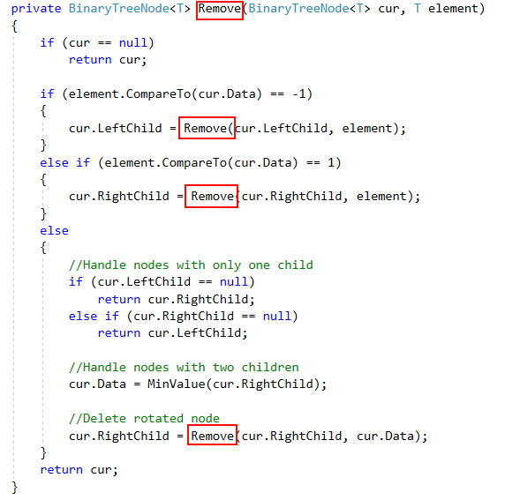

Slide 8
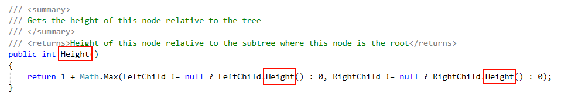

Slide 9
Lab
On canvas there is a zip file containing a fairly interesting folder structure with a single file hidden inside.
Your objective is to use FileIO and Recursion to find the path of the file.
FYI, when I was creating this lab I created almost 10 million folders on my computer… 5 folders 10 layers deep… 5^10
Changing to 3 folders 10 layers deep gives 3^10 which is about 60,000 folders to look through!

